Slide 1
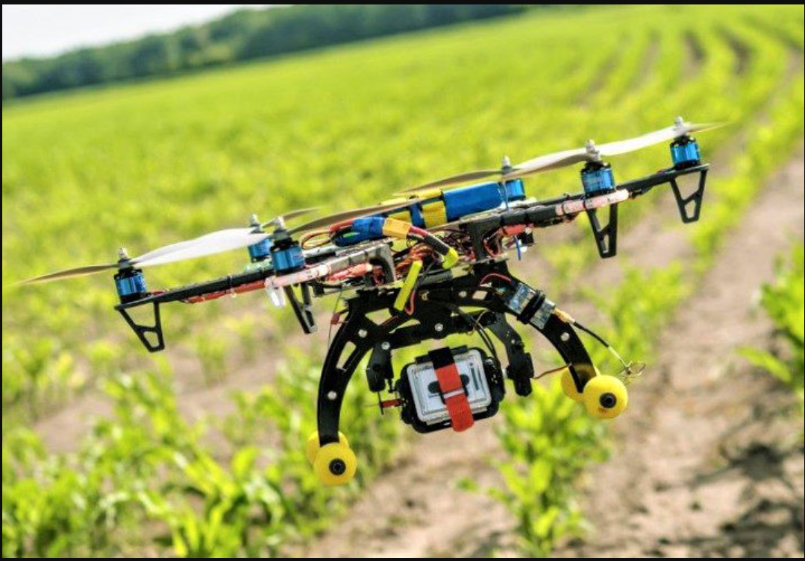
Autonomous Garden Monitoring
By Team 7

Slide 2
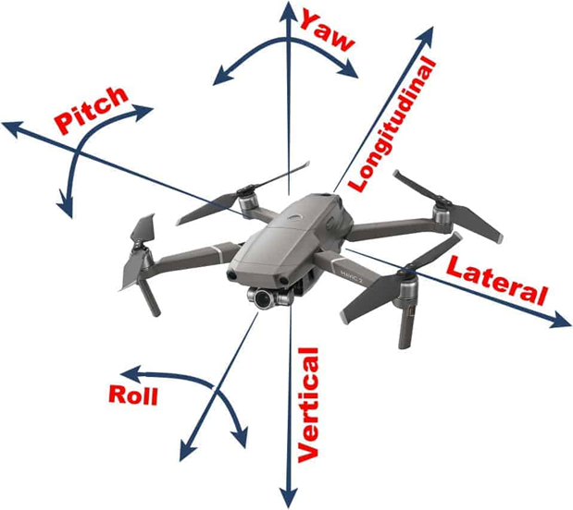
What’s Attitude?
What’s Attitude?
Attitude is the angular difference measured between an airplane's axis and the line of the Earth's horizon.
<Attitudes commands of Tello drone >
pitch = the degree of the attitude pitch.
roll = the degree of the attitude roll.
yaw = the degree of the attitude yaw.
Premise:
Drone should be stopped when it takes a picture or video

Slide 3
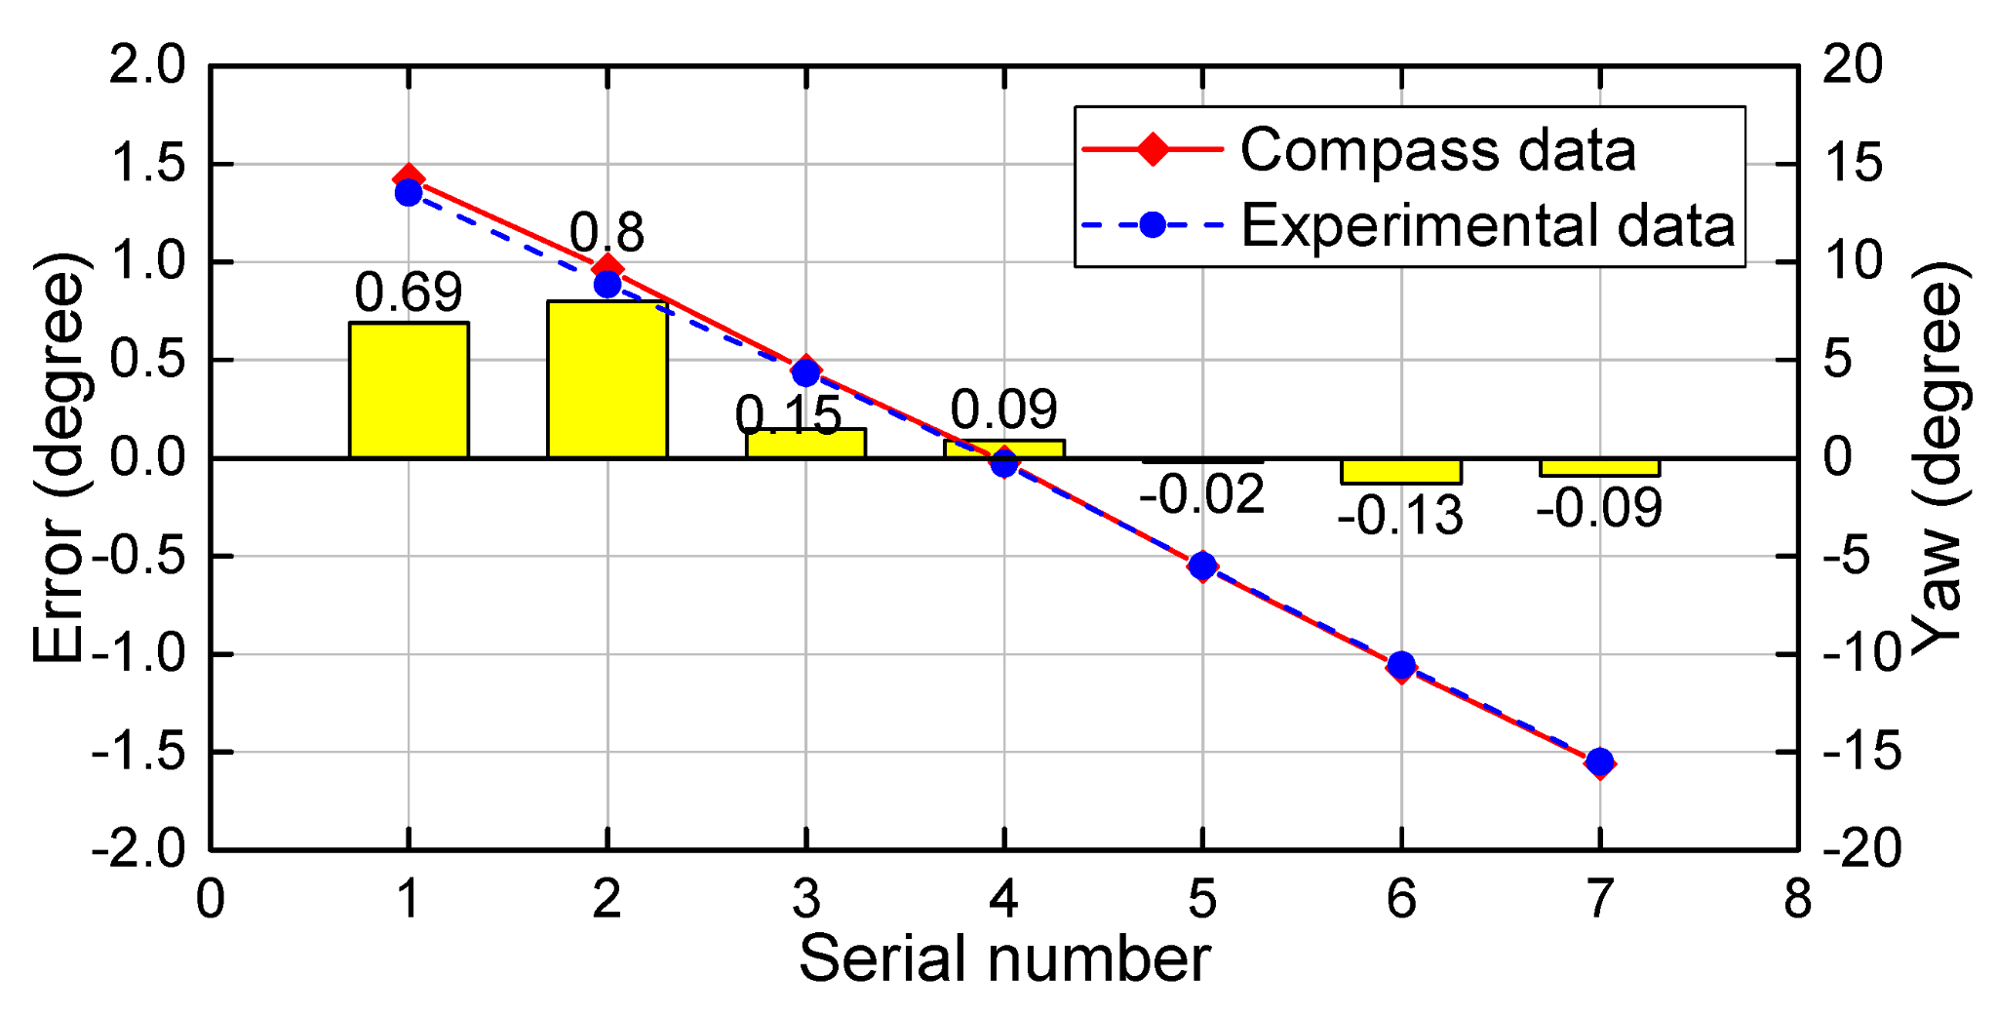
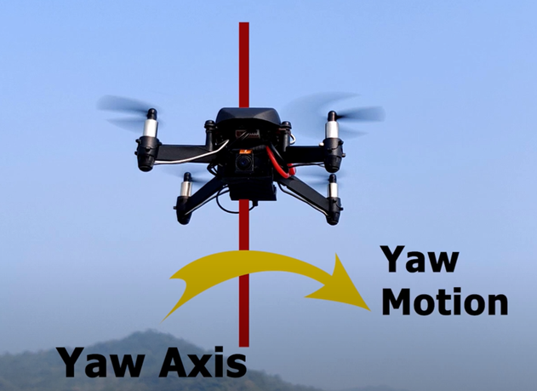
<Yaw>
Experiment compares the experimental result and ground truth (electronic compass values) for attitude angle
According to the research article,
The yaw angle has high accuracy when yaw angles vary around 0°, and the error increases with the increases of the yaw angle.

Slide 4
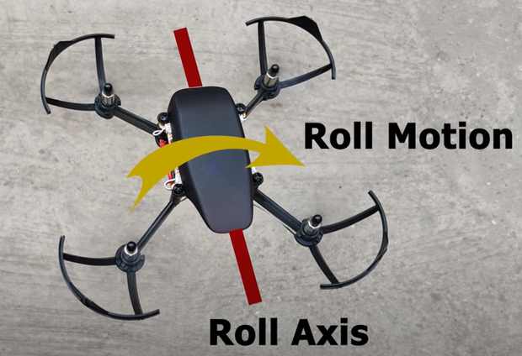
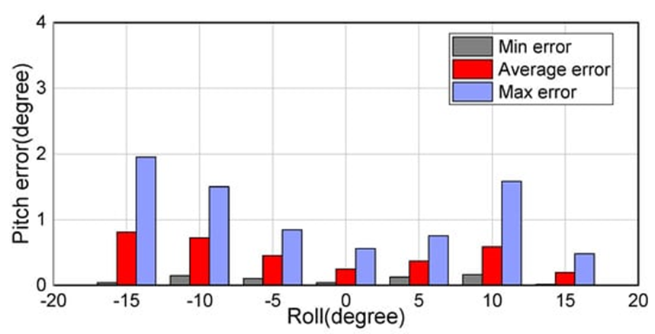
<Roll>
In the experiment, roll and pitch angles were changed in increments of 5° from −15° to 15° and −15° to −40° with a yaw angle of about 0° unchanged.
The proposed method achieves an average error of 0.25° at a roll angle of about 0°. The error in the attitude angles gradually increases as the roll angle departs from 0∘.

Slide 5
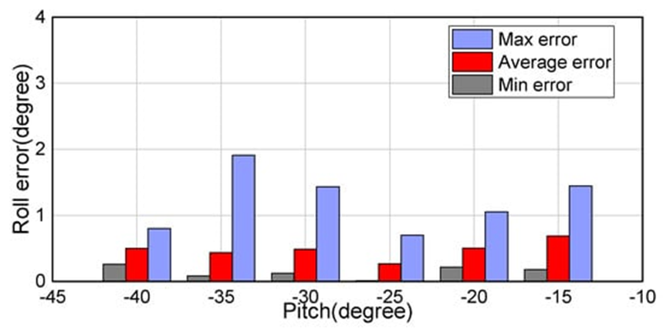
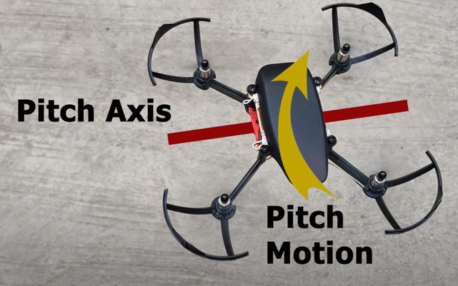
<Pitch>
At a roll angle of about 0°, the graph shows -25 pitch(degree) shows minimum average error.
As a result, ideal set of the attitude values will be
<Yaw: 0°, Roll:0° , Pitch:-25°>

Slide 6
<Source>
https://www.mdpi.com/1424-8220/18/8/2655/htm
https://en.wikiversity.org/wiki/Aircraft_piloting/Attitude_flying
https://www.youtube.com/watch?v=bJFHZpgh6VU&ab_channel=DronaAviation
https://dl-cdn.ryzerobotics.com/downloads/Tello/Tello%20SDK%202.0%20User%20Guide.pdf

Slide 7

End

